Slide 1
Loan Prediction (Analytics Vidhya Practice Dataset)
Brandon A.

Slide 2
Problem overview
About Company
Dream Housing Finance company deals in all home loans. They have presence across all urban, semi urban and rural areas. Customer first apply for home loan after that company validates the customer eligibility for loan.
Problem
Company wants to automate the loan eligibility process (real time) based on customer detail provided while filling online application form. These details are Gender, Marital Status, Education, Number of Dependents, Income, Loan Amount, Credit History and others. To automate this process, they have given a problem to identify the customers segments, those are eligible for loan amount so that they can specifically target these customers. Here they have provided a partial data set.
TL;DR -> Binary classification problem
https://datahack.analyticsvidhya.com/contest/practice-problem-loan-prediction-iii/

Slide 3
Data
Name Type Description *P Value
RecordID
Loan_ID Typeless Unique Loan ID
Target
Loan_Status Flag Loan approved (Y/N)
Demographics
Gender Flag Male/ Female 0.757
Married Flag Applicant married (Y/N) 0.044
Self_Employed Flag Self employed (Y/N) 0.924
Education Flag Applicant Education 0.043
(Graduate/ NotGraduate)
Financials
Dependents Ordinal Number of dependents 0.449
ApplicantIncome Cont Applicant income (not sure unit) <2e-16
CoapplicantIncome Cont Coapplicant income (not sure unit) 3.82e-06
Credit_History Flag credit history meets guidelines 7.926165e-40
Loan Details
LoanAmount Cont Loan amount in thousands 0.365
Loan_Amount_Term Ordinal Term of loan in months 0.179
Property_Area Nominal Urban/ Semi Urban/ Rural 0.002
*Predictor Importance – Either Fischer ChiSquare, Correlation or ANOVA

Slide 4
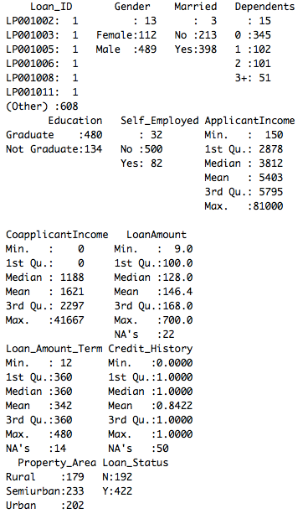
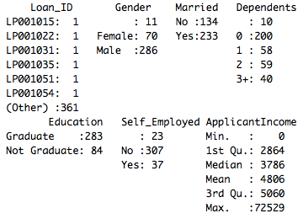
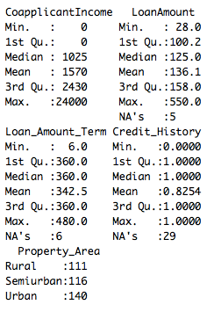
Data profile
Training Set – 13 variables 614 observations
Random partition – 414 training, 200 testing
Validation Set – 12 variables 367 observations
Same structure as training set
Target
summary(<FOO>)
Some missing records, most severe for Credit_History
ApplicantIncome and CoapplicantIncome seems to have some outliers
CoappliantIncome as zero should be treated differently
Target is not severely unbalanced

Slide 5
Missing value visualization

Slide 6
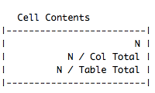
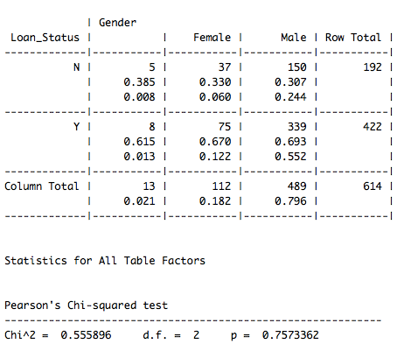
Overall trend – Demographics - Gender
Total records: 614 / 614

Slide 7
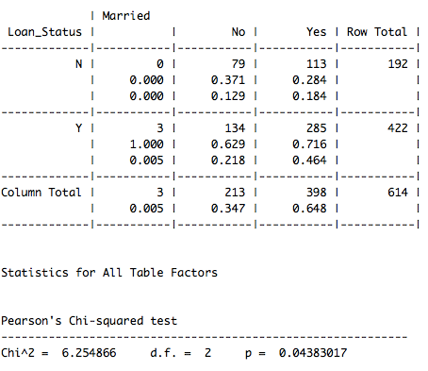
Overall trend – Demographics - Married
Total records: 614 / 614

Slide 8
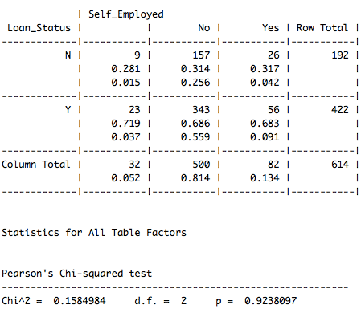
Overall trend – Demographics – Self_Employed
Total records: 614 / 614

Slide 9
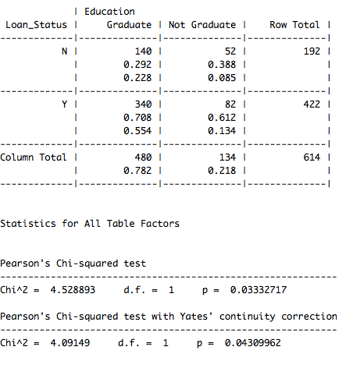
Overall trend – Demographics - EDUCATION
Total records: 614 / 614

Slide 10
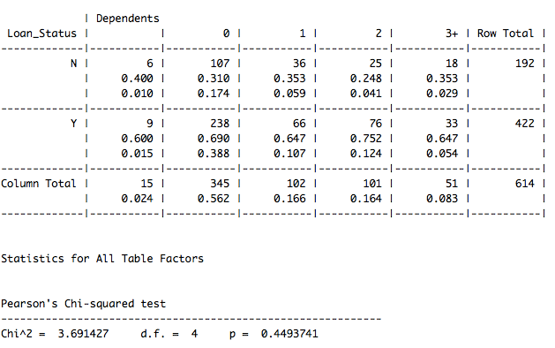
Overall trend – financials - Dependents
Total records: 614 / 614

Slide 11
Overall trend – financials – Applicant income and coapplicant
Total records: 614 / 614

Slide 12
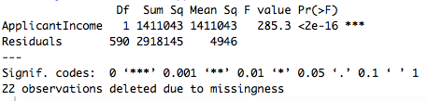
Overall trend – financials – Applicantincome
Total records: 614 / 614

Slide 13
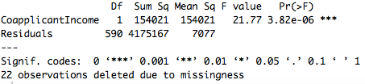
Overall trend – financials – COApplicantincome
Total records: 614 / 614

Slide 14
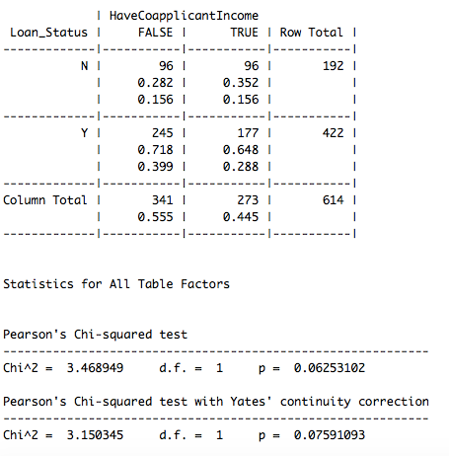
Whether Coapplicantincome = o has special meaning
There is difference but significant value is ’borderline’

Slide 15
Whether Coapplicantincome = o has special meaning (2)
TBD – cut coapplicant income into equal cats and plot linear

Slide 16
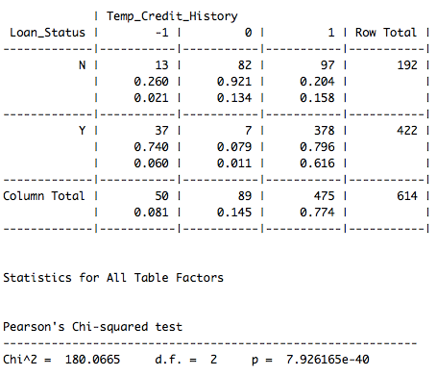
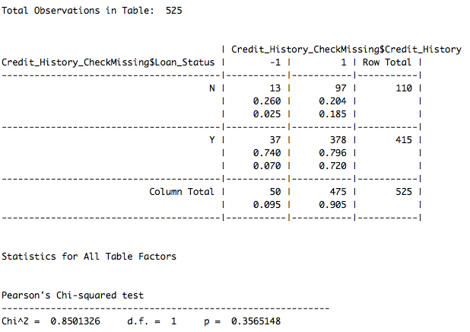
Overall trend – Financials – CREDIT_HISTORY
Recoded NA to -1
Proportion of those with NA in credit history is similar to 1 and no significant difference (see below P value = 0.356)

Slide 17
Overall trend – LOAN DETAILS – Loan amount and term
Applied jitter

Slide 18
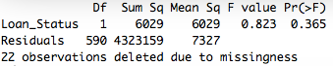
Overall trend – LOAN DETAILS – LoanAmount
Used ANOVA to calculate F Statistic
Total records: 614 / 614

Slide 19
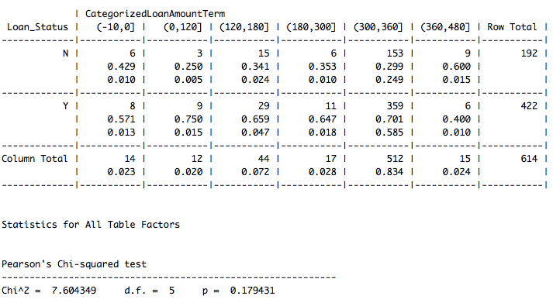
Overall trend – LOAN DETAILS – LOANTERM
Total records: 614 / 614

Slide 20
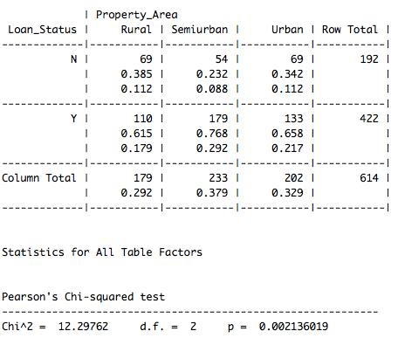
Overall trend – LOAN DETAILS – Property_Area
Total records: 614 / 614

Slide 21
Modeling PLan
Predict using the 6 fields, recoding missing credit history
Use following algo:
Logistic Regression
CART
CHAID
Random forest
Neural Net??
Observe predictive accuracy and predictor importance
Retry with median imputation
With few missing value, not doing complex imputation here

Slide 22
Data cleansing
Impute with mean
Outlier -> see whether can improve accuracy

Slide 23
Model evaluation
Given the business context, use the following metrics:
AUC, Accuracy, Recall, Precision, F1

